Slide 1
Real-time Video effect
Hongyi Sun(hs3497) Qiongxuan Tan(qt310)

Slide 2
Project Introduction.
01
Principles and Formulas.
02
CONTENTS
Application and Future work
03
Conclusion and Demo
04

Slide 3
Project Introduction.
/01

Slide 4




Project Introduction
Instagram
TikTok
VSCO
Snapchat
Today, it is fashionable to post videos on social networks. And videos with some special effect are likely to draw more attention than the other. As people enjoy watching the effect while recording the video than applying afterward, real-time video effect are crucial for the need of social media.

Slide 5
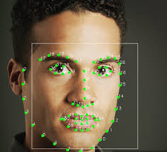
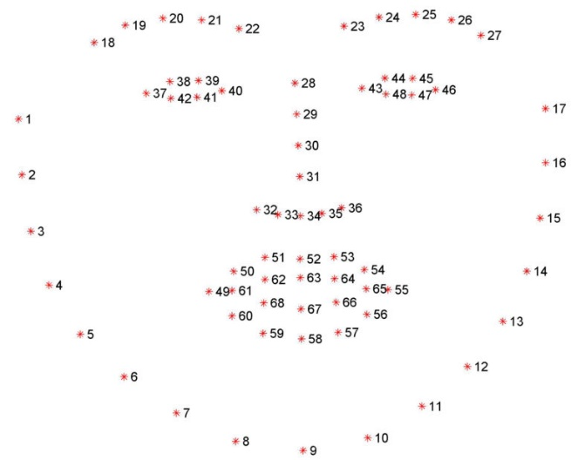
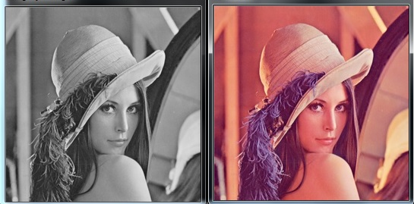
Project Introduction
In this project, we build software that can apply multi special effects on video in real time. We implement effects such as some basic style filters and animation style filters.
The basic filters includes simple black-and white filter, pencil sketch filter, RGB-Glitch filter, cartoon filter and video shadow filter. We also write our own animation style filter, which uses some image fragmentation algorithm so that we can apply different parameters to different parts of the frame.
Also, we switch filters by blinking our eyes, which will be detected due to the change of eye contour.

Slide 6
Principles and Formulas.
/02

Slide 7
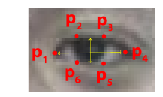
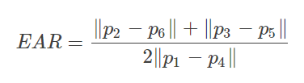
Principles and Formulas.
eye aspect ratio (EAR)
EYE_AR_THRESH = 0.22
EYE_AR_CONSEC_FRAMES = 3
Soukupová T, Cech J. Real-time eye blink detection using facial landmarks[C]//21st Computer Vision Winter Workshop. 2016.

Slide 8
Conclusion and Demo.
/04

Slide 9
Thanks.

